Slide 1

Discussion on ‘why?’

Slide 2
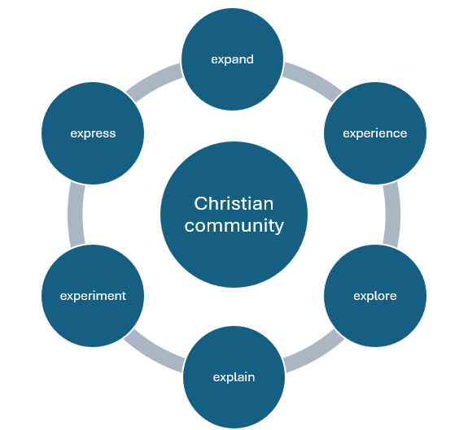
How? E-circle model

Slide 3
Discussion on ‘how?’

Slide 4
What? A ‘more than’ church
~actions > words
~members > minister
~community > congregation
~ Monday > Sunday

Slide 5
What’s next?
~growing teams
~growing youth workers
~zoom meeting
~ event

Slide 6
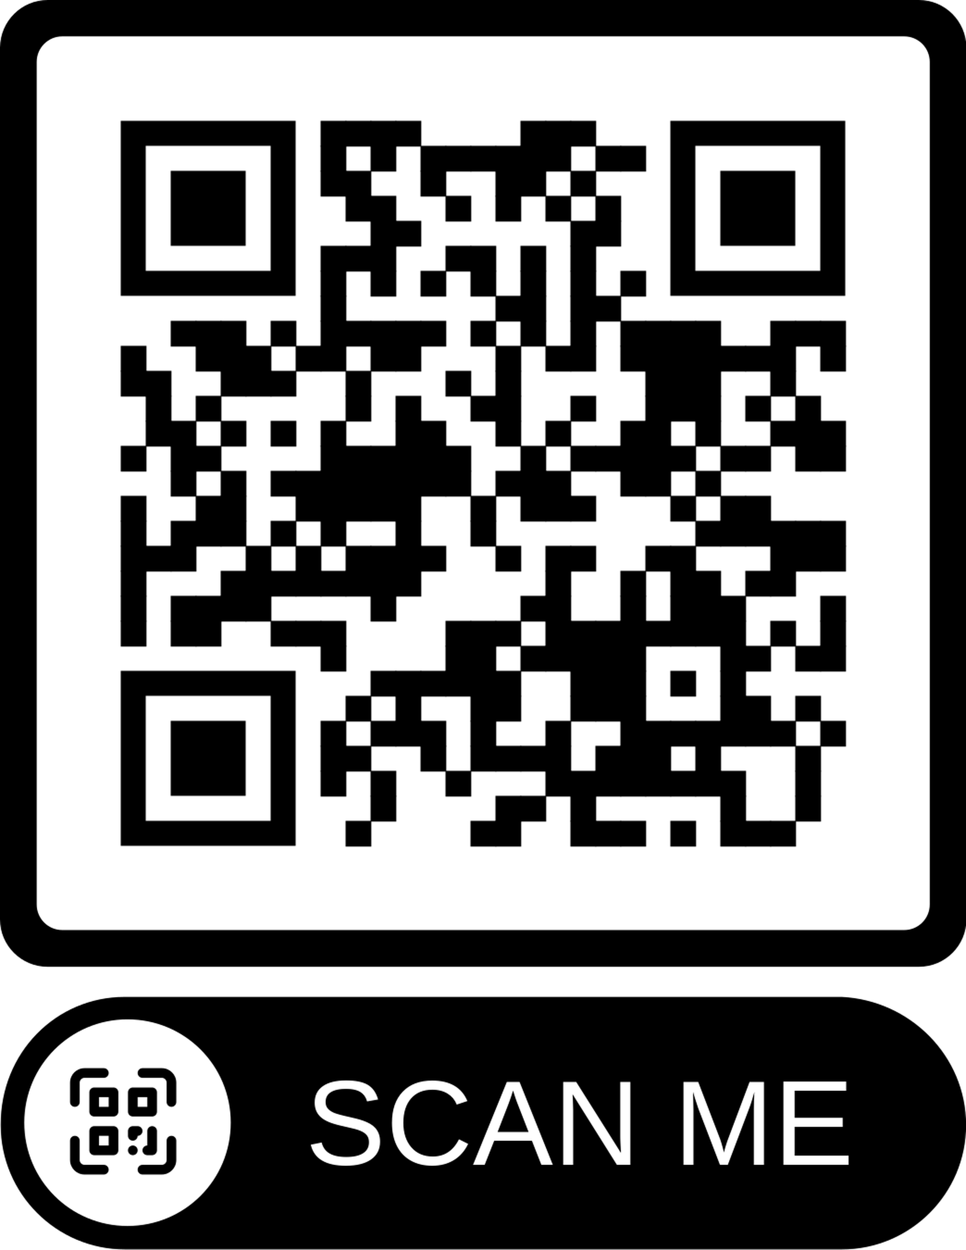
Paul Beautyman
Youth Work Journeys paulbeautyman67@gmail.com
07572 813 695

