Slide 1
PRESBYTERY OF CLYDE · CONGREGATIONAL SUPPORT COMMITTEE
Congregational Action Plan
Information Session for Ministers, Session Clerks and Kirk Session Representatives
A two-hour gathering · Planning cycle 2027 to 2031
Notes:
Welcome everyone as they arrive. Four representatives from each congregation: the minister, the Session Clerk, and two others chosen by the Kirk Session.

Slide 2





Why We Are Doing This
It is required
Act VIII 2021 (as amended) requires every charge to have a five-year Action Plan.
It sits under the Mission Plan
Your Action Plan must be consistent with the approved Presbytery Mission Plan.
The Kirk Session owns it
The Kirk Session prepares, approves and submits the plan.
It turns us back to mission
The focus moves from structures and administration to God’s mission in your parish.
It starts a rhythm
Plans are reviewed every year and re-evaluated every five. This is not a one-off exercise.
Notes:
Short input from the Committee on the background to Action Plans. Aim: everyone leaves with a clear sense of what is required and why.
Key point: after the often painful and challenging Mission Plan process, this lets congregations focus less on administration and structure, and more on the mission of God in our parishes and how we reach our communities with the Good News of Jesus.

Slide 3









THE SHAPE OF THE PLAN
What the Action Plan Covers
Five mission areas
Four cross-cutting areas
Worship and Teaching
Finance
Pastoral Care and Fellowship
Communications
Youth and Children
Property
Local Mission and Community Outreach
HR / Staffing
Wider Mission: ecumenism, interfaith, World Church
These four straddle every mission area. Almost no outcome lives in one place.
Plus a vision for your congregation’s mission over the next five years, and honest reflection on resources and challenges.
Notes:
Five mission areas, four cross-cutting areas, a five-year vision, and honest reflection on resources and challenges.

Slide 4



WALKING ALONGSIDE YOU
The Committee’s Role
Guidance
Comment on drafts
Facilitators
We provide the three documents and answer questions as you work: the Template, the Completion Guide and the Vision Guide.
We give written comments on every draft plan submitted by 30 November 2026, returned within six weeks.
Named Congregational Facilitators walk with each Kirk Session through the months ahead. You will meet yours today.
Talk to us at any point. Do not wait until something has stalled.
Notes:
The Congregational Support Committee exists to walk alongside Kirk Sessions through this process.

Slide 5
Completing the Action Plan
The structure, a worked example, and the questions each Kirk Session will need to answer.
Notes:
SCRIPT (Slide 1): My part of today’s session is to show you how to complete the Action Plan itself. We won’t try to write a whole plan in 25 minutes. We’re going to look at the structure, work through an example and consider the questions each Kirk Session will need to answer.

Slide 6


COMPLETING THE ACTION PLAN
What Kind of Plan Is It?
High-level and five years long
It sets direction. It does not record every detail.
Grown from your Vivid Vision Day
It reflects the hopes, priorities and direction discerned there, whether that day has happened or is still ahead.
Old and new together
It can include work already happening, work that needs reviewed, and new steps you hope to take.
Short and clear
Use bullet points. The people responsible for each area develop the detail later.
Notes:
SCRIPT (Slide 2): The Action Plan is a high-level plan covering five years. It grows from the hopes, priorities and sense of direction identified through the congregation’s Vivid Vision Day. Some congregations will already have held their Vivid Vision Day. Others may still be preparing for it. The Action Plan should reflect what has emerged, or what later emerges, from that time of prayerful conversation and discernment. It can include work that’s already happening, work that needs reviewed and new steps the congregation hopes to take. Keep the entries short and clear, using bullet points wherever possible. The detailed arrangements can be developed later by the people responsible for each area.

Slide 7
COMPLETING THE ACTION PLAN
What’s in the Template?
Page 1
Pages 2–6
Page 7
Page 8
Your congregation
Five mission areas
The joined-up picture
Specific projects
Your name and three factual questions: has a union taken place, is your ministry allocation in place, are listed buildings sold. Write “not applicable” where needed.
One page for each area of congregational life. Every page follows the same pattern.
Gathers the finance, communications, property and staffing points from every earlier page.
A desired outcome in one of the four resource areas. Copy the page if you need more than one.
Boxes in the Word template expand as you type. You will not run out of space.
Notes:
SCRIPT (Slide 3): Page 1 asks for the congregation’s name and factual information about its relationship with the approved Presbytery Mission Plan. You’re asked whether any planned union has taken place, whether the full ministry allocation has been received and whether buildings identified for disposal have been sold. If something doesn’t apply, write “not applicable”. Use the comments box for any brief explanation. Pages 2 to 6 cover five areas of congregational life: Worship and Teaching, Pastoral Care and Fellowship, Youth and Children, Local Mission and Community Outreach, and Wider Mission. Page 7 gathers the implications for finance, communications, property and staffing. Page 8 can be used for a particular project or desired outcome involving one of those four resource areas.

Slide 8





COMPLETING THE ACTION PLAN
The Pattern for Each Mission Area
1
2
3
4
5
Desired outcome
Actions by year
Signs of progress
Resources
Status
What change do you hope to see?
Year 1, Year 2 and Years 3 to 5.
What will you see in reality?
Responsibility, resources and challenges.
Not Started, In Progress, Complete.
Learn the pattern once. Use it on every page.
Notes:
SCRIPT (Slide 4): Pages 2 to 6 all follow the same pattern. First, name the desired outcome. What change does the congregation hope to see? Next, identify the actions for Year 1, Year 2 and Years 3 to 5. Then describe what progress will look like in reality. The remaining boxes cover responsibility, resources, possible challenges and the current status of each action. Once you understand this pattern, you can use it throughout the document.

Slide 9


COMPLETING THE ACTION PLAN
Writing a Desired Outcome
AN ACTIVITY
“Run pastoral-care training.”
TALK TOGETHER
What is one change you hope to see in your congregation over the next five years?
A DESIRED OUTCOME
“We hope to strengthen relationships across the congregation so that people feel known, supported and able to care for one another.”
If your Vivid Vision Day is still ahead, note areas that may need attention now. Revisit them after the day so the final plan reflects what the congregation discerned.
A useful way to begin: “We hope to strengthen or develop [something], so that [something changes].”
Notes:
SCRIPT (Slide 5): A desired outcome describes the difference you hope the work will make. “Run pastoral-care training” is an activity. The desired outcome might be: “We hope to strengthen relationships across the congregation so that people feel known, supported and able to care for one another.” Training could then be one of the actions that helps the congregation move towards that outcome. The outcome should connect with the hopes and priorities emerging from the Vivid Vision Day and be clear enough to guide future choices. If your congregation hasn’t held its Vivid Vision Day yet, begin identifying areas that may need attention, then revisit them after the day.
DISCUSSION: Take a moment to think about your own congregation. What’s one change you’d hope to see over the next five years? Pause briefly and invite two or three responses.

Slide 10
COMPLETING THE ACTION PLAN
Turning the Outcome into Action
Year 1
Year 2
Years 3–5
Listen and research.
Review existing work.
Take one realistic first step.
Build on what Year 1 taught you.
Extend what worked.
Adjust what did not.
Describe the longer-term development you hope will follow.
Stay directional. Detail can wait.
Give each action its own bullet point. Planning nothing new in a year is fine while you wait for people, decisions or resources.
what could be one realistic Year 1 action for pastoral care?
Talk together:
Notes:
SCRIPT (Slide 6): The next part asks what the congregation will do in Year 1, Year 2 and Years 3 to 5. Year 1 might involve listening, research, reviewing existing work or taking a realistic first step. Year 2 can build on what’s been learned during the first year. Years 3 to 5 can describe the longer-term development you hope will follow. Each action should have its own bullet point. It’s fine to say that nothing new is planned in a particular year where the congregation is waiting for people, decisions or resources.
DISCUSSION: Returning to our pastoral-care example, what could be one realistic action for Year 1? Pause and invite two or three suggestions. Possible actions: reviewing current arrangements, identifying gaps, offering training for pastoral visitors, or creating a clearer way for people to request support. These actions guide the work while leaving practical details to those responsible.

Slide 11


COMPLETING THE ACTION PLAN
What Will Progress Look Like?
PASTORAL CARE EXAMPLE
What might we see happening?
What might people experience differently?
Signs of progress
Contact happens consistently.
Requests for support get a timely response.
Volunteers feel trained and confident.
People say they feel known and supported.
What could we count or record?
What feedback could we gather?
Mix things you can count with changes people describe in their own words.
Notes:
SCRIPT (Slide 7): The form asks what progress will look like in reality. This is where we identify the signs that will help the Kirk Session recognise whether the work is bearing fruit. For pastoral care, signs of progress might include more consistent contact, requests for support receiving a timely response, volunteers feeling trained and confident, or people reporting that they feel known and supported.
DISCUSSION: Thinking about our example, what else might show us that progress is being made? Pause and invite two or three responses. Aim for a mixture of things you can count and changes you can recognise through people’s experiences or stories.

Slide 12


COMPLETING THE ACTION PLAN
Responsibility, Resources and Challenges
Governance
Cross-cutting areas
The Kirk Session keeps oversight. It may delegate to a committee or working group. Note roles for the minister, safeguarding coordinator or health and safety coordinator.
Tick finance, communications, property or staffing where the work touches them. Describe briefly what you will need: people, skills, money, buildings, equipment, Presbytery support.
Challenges: the honesty box
Status
What might limit or delay the work? Where are you already stretched? What depends on a decision, appointment or resource not yet in place? Naming it helps Presbytery help you.
Mark each action Not Started, In Progress or Complete. You update this at every annual review.
Notes:
SCRIPT (Slide 8): The governance box asks who’ll have oversight of the work. Most work remains under the oversight of the Kirk Session, although responsibility may be delegated to a committee or a short-term working group. Some areas also carry particular responsibilities for the minister, safeguarding coordinator or health and safety coordinator. The plan then asks whether the work will affect finance, communications, property or staffing. Tick the relevant areas and briefly describe what will be needed. Think about people, skills, training, money, buildings, equipment and support from Presbytery. The challenges box is a place for honesty. What might limit or delay the work? Where is the congregation already stretched? Does anything depend on a decision, appointment or resource that isn’t yet in place? Naming these challenges helps the congregation plan realistically. It can also help Presbytery recognise where support may be useful. Each action should be marked as Not Started, In Progress or Complete.

Slide 13

COMPLETING THE ACTION PLAN
Bringing the Sections Together
PAGES 2–6
Worship and Teaching
PAGE 7
One joined-up picture
Pastoral Care and Fellowship
Carries every finance, communications, property and staffing point onto one page.
Shows where different plans depend on the same people, money or buildings.
Helps the Session judge whether the whole plan is achievable.
Youth and Children
Local Mission and Outreach
Wider Mission
Page 8: use it for a stand-alone project in finance, communications, property or staffing. Copy the page for each extra project.
Notes:
SCRIPT (Slide 9): Once pages 2 to 6 have been drafted, the finance, communications, property and staffing implications are carried across to page 7. This creates a joined-up picture. Several parts of the Action Plan may depend on the same volunteers, budget, building work or communication support. Page 7 helps the Kirk Session see those connections and consider whether the full plan is achievable. Page 8 is available if the congregation has a particular desired outcome involving finance, communications, property or staffing. The page can be copied if more than one additional project is needed.

Slide 14
COMPLETING THE ACTION PLAN
What Happens Next?
For each mission area
Practical points
Begin with the desired outcome.
Share the drafting. Different people can prepare sections.
Appoint one person to bring the material together.
Check the full draft against your Vivid Vision Day. If the day is still ahead, keep the draft open for review.
Submit to Presbytery for feedback and support, adjust, then formally adopt.
Identify realistic actions across the five years.
Describe the signs of progress.
Name who takes responsibility.
Consider resources and challenges.
Record the current status.
Aim for a plan that is clear, honest and achievable,
rooted in your calling and open to where God leads.
Notes:
SCRIPT (Slide 10): The same process can now be followed for each mission area. The Action Plan doesn’t need to be written by the whole Kirk Session word by word. Different people can help prepare sections. It’s helpful to appoint one person to bring the material together so the completed document is clear and consistent. The full draft should be checked against the hopes, priorities and sense of direction that emerged from the congregation’s Vivid Vision Day. Where the Vivid Vision Day is still to take place, the draft should remain open for review. It’ll be submitted to Presbytery for feedback and support. The Kirk Session can then make any necessary adjustments before formally adopting the completed plan. The aim is a plan that’s clear, honest and achievable, rooted in the congregation’s calling and open to where God leads over the years ahead.

Slide 15
God’s Mission, Not Ours
“The Church does not have a mission. God has a mission, and the Church is invited to share in it.”
The first question is not “What should we do?” It is “Where is God already at work?”
Vision is received before it is built. Listen first, then plan.
Plans are faithful responses, not corporate targets. An honest plan beats a polished plan.
The community, those who have drifted away, and the Spirit all have things to say.
Notes:
2:50 / 7:50, 10 minutes. Helps the session change from talking of admin and form filling to talking about discernment, listening and vision.
1 Corinthians 3:6-7: I planted the seed, Apollos watered it, but God has been making it grow. So neither the one who plants nor the one who waters is anything, but only God, who makes things grow.

Slide 16
Discerning the Vision, Building the Plan
1
2
3
4
5
Preparation
Listening widely
Discerning the vision
Building the plan
Draft, test, submit
The Session commits, prays, agrees the timeline and decides who to hear from.
Three streams: congregation, those who have drifted, and the community.
Gather what was heard, find the themes, draft the five-year vision.
Work through each Action Plan area with the same five questions.
Share with the congregation, revise, approve, submit.
1–2 weeks
3–4 weeks
1–2 weeks
2–3 weeks
1–2 weeks
Roughly eight to thirteen weeks in total. A guide, not a prescription. Slow down where you need to.
Notes:
A walk-through of the five-stage process in the Vision Guide. The Committee recommends this to every Kirk Session, offered as a guide and not a prescription. Added together the stages take roughly eight to thirteen weeks. Some Sessions will move faster; some need longer, especially where listening reveals more than expected.

Slide 17
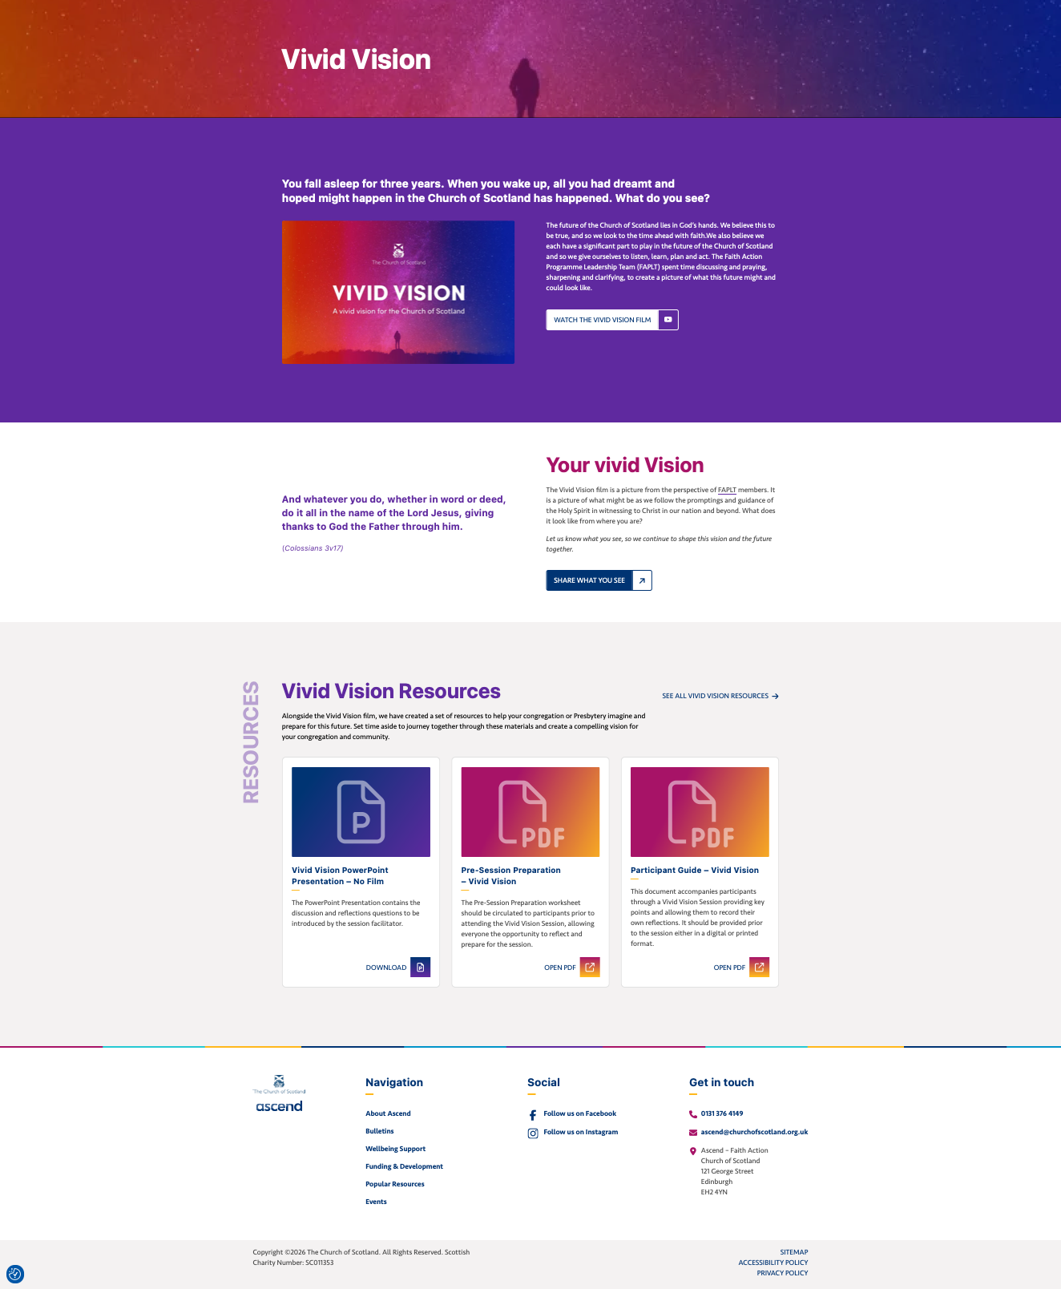


THE HEART OF THE PROCESS
Three Voices, Three Streams
The gathered congregation
Those who have drifted away
Voices from the community
An adapted Vivid Vision session, open to everyone. Personal invitations to occasional attenders, not just the regulars.
Five to ten one-to-one conversations over coffee. A learning exercise, not a recruitment one. Listen. Do not defend.
Headteachers, group leaders, councillors, neighbours. Twenty focused minutes each. Ask what the community needs.
The Action Plan will only be as good as the listening behind it.
Notes:
The listening stage is the heart of the process. Three different conversations, each with different questions and a different invitation. Most Kirk Sessions only hear regularly from the first group, and often not in a planned, intentional way.

Slide 18
Meet Your Congregational Facilitators
A Facilitator is
A Facilitator is not
Available to your Kirk Session by phone, email or in person.
Willing to attend a Session meeting, especially at the start.
On hand to help you plan who to listen to and how.
An outside view on your draft vision and draft plan.
Your route to Committee and Presbytery support.
A writer. The Action Plan belongs to the Kirk Session.
An inspector. They walk alongside you, not over you.
A substitute for the minister or Session Clerk. Leadership of this work stays where it belongs.
Notes:
The Committee is appointing Congregational Facilitators to walk alongside every Kirk Session. They are your named contacts, sounding boards, and route into the Committee. After this input, each congregation pairs with its Facilitators for a short conversation in the room.

Slide 19


Your First Conversation
Who is around the table from your congregation, and what gifts and roles do they bring?
What do you already know about your context that your Facilitator should know?
When does your Kirk Session next meet? Could the Facilitator come along?
What worries or questions do you want to raise now?
Notes:
Each congregation’s four representatives pair with their Congregational Facilitators for a short conversation in the room. The aim is simply to meet, exchange contact details, and agree how you would like to keep in touch. You will have much more time together over the months ahead.

Slide 20
The Timeline
June 2026
Template approved. Kirk Sessions encouraged to begin considering their Action Plan.
Aug–Sep 2026
Information sessions and guidance on vision building.
Sep–Nov 2026
Kirk Sessions discern and complete a draft Action Plan.
By 30 Nov 2026
Draft plans submitted. Comments returned within six weeks.
Jan–Feb 2027
Final adjustments. Formal adoption by the Kirk Session.
14 Feb 2027
Action Plan submitted to Presbytery in the Attestation Process.
March 2027
Committee reports to Presbytery on submission of Action Plans.
The two dates in dark blue are your deadlines.
Notes:
Every participant should leave knowing what is required of their Kirk Session, by when. The key date is 31 November 2026 for draft plans; the Committee returns comments within six weeks.

Slide 21
YOU ARE NOT DOING THIS ALONE
Support Available, and What Follows
Support from the Committee
After the plan is approved
Your named Congregational Facilitator, throughout.
Written comments on every draft submitted by 30 November 2026.
Three documents: the Template, the Completion Guide and the Vision Guide.
A conversation at any point. Do not wait for something to stall.
Review the plan every year, ahead of Presbytery’s annual attestation.
Update the status of each item.
Adjust where the situation has changed. The plan is a living document.
Re-evaluate every five years, in line with the Presbytery Mission Plan.
The Presbytery would rather receive an honest plan that names its limits than a polished plan that papers over them.
Notes:
Support: named Facilitator throughout; written comments on every draft submitted by 31 November 2026; the three documents; conversations at any point. After approval: annual review ahead of Presbytery attestation, status updates, adjustments where things change, five-yearly re-evaluation in line with the Presbytery Mission Plan.

Slide 22

Questions and Answers
Ask us anything
Where we do not know the answer, we will say so and come back to you.
Notes:
Open floor. Invite questions on anything not covered, or anything needing more clarity. Committee members respond. Where we do not know the answer we will say so and come back to you.

Slide 23

Take This Back to Your Kirk Session
At your next Session meeting
Use the three documents
Share what you heard today and start the conversation.
The Template
The form you submit. Read it early. Do not start filling it in before Stage 4.
Test the five-stage process and timeline against your context.
Agree who leads each stage.
The Completion Guide
Page-by-page reference with examples. Use it as you fill things in.
Name the missing voices in your parish.
Plan how you will use your Facilitators.
The Vision Guide
Your working document through discernment. The one you will return to most.
This work is important and belongs to God. Walk it carefully, prayerfully and honestly.
Notes:
The representatives have heard the same thing. The Kirk Session as a whole has not. Share what you heard as soon as you can and start the conversation about how your congregation will approach this work. Stay in touch with your Facilitators; if they cannot help with a question, they will route it to the Committee.

Slide 24
“Being confident of this, that he who began a good work in you will carry it on to completion until the day of Christ Jesus.”
PHILIPPIANS 1:6
Notes:
3:55 / 8:55, 5 minutes. End as we began, in prayer, committing the work to God to whom it belongs.
Closing prayer: God of every parish and every person, of every faithful elder and every weary minister, of every congregation that hopes and every community that waits: bless the work we have begun today. Give your wisdom to the Kirk Sessions we represent. Give your patience to the Facilitators who will walk alongside them. Give your courage to all of us as we listen, plan, and respond to your call. We commit this work, and the months ahead, into your hands. Through Jesus Christ our Lord. Amen.

